Slide 1
ROCO218: Control Engineering Dr Ian Howard Tutorial 1 ROCO204 2012 Exam example Transfer function of block diagram

Slide 2
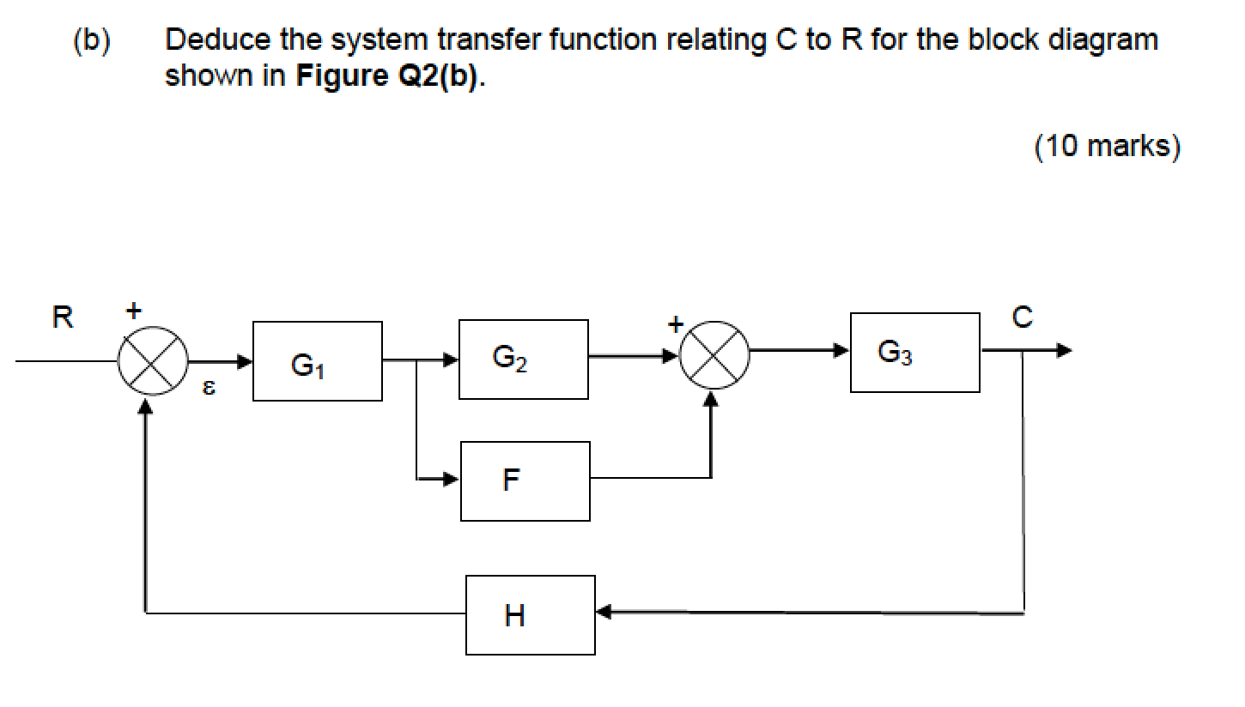
Q1: Simplify diagram
-
+

Slide 3
Block diagram reduction techniques
Combining blocks in cascade or in parallel
2. Moving a summing point from behind a block

Slide 4
Block diagram reduction techniques
3. Moving a summing point ahead of a block
4. Moving a pickoff point from behind a block
5. Moving a pickoff point from ahead of a block

Slide 5
Block diagram reduction techniques
6. Eliminating a feedback loop
7. Swap order of two neighboring summing points

Slide 6
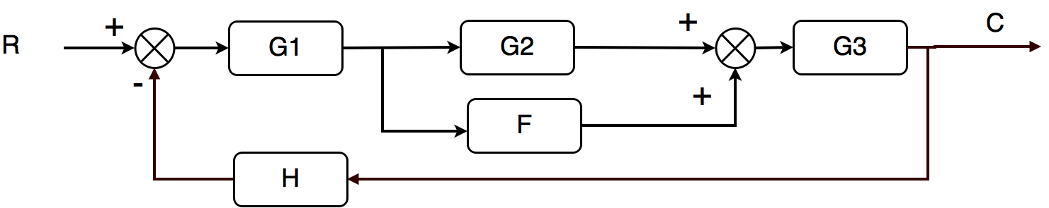
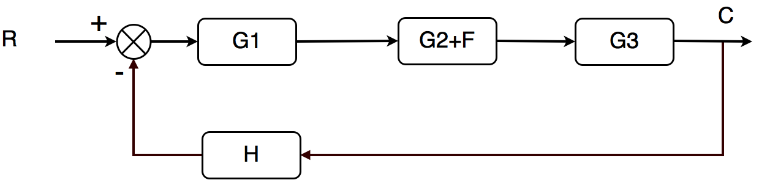
Q1: Simplify diagram

Slide 7
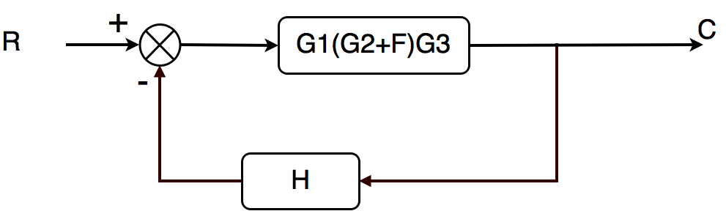
Q1: Simplify diagram

Slide 8
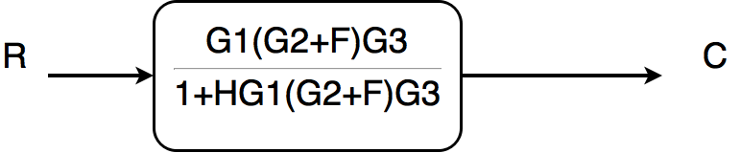
Q1: Simplify diagram

Slide 9
ROCO218: Control Engineering Dr Ian Howard Tutorial 1 2016R exam for ROCO319 Modern Control Solutions to relevant questions

Slide 10
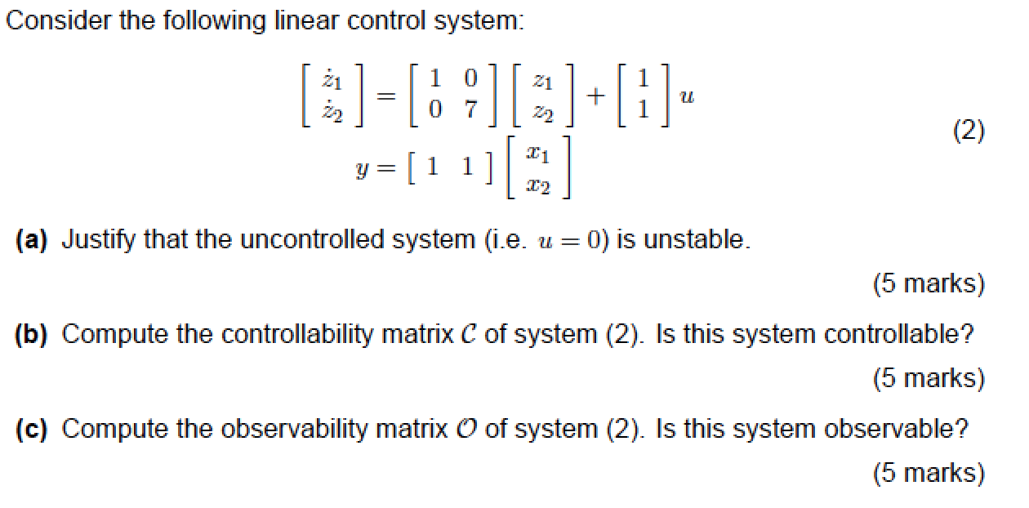
Q2: State space analysis

Slide 11
Q2: State space analysis
State space equations take the form
The given system state space equations are
Therefore the system matrices are
NB: Since system matrix A is diagonal, by inspection we can see that the eigenvalues of the system are given the diagonal elements of the system matrix A
Therefore λ = 1,7
However here we will proceed and adopt an analysis here that will deal with the general case

Slide 12
Q2: State space analysis
Given system matrix A
The eigenvalues of matrix A must satisfy the equation
Where X is the state vector
Where I is the identity matrix
This equation has a non-zero solution X if and only if the determinant of the matrix (A-I)=0
Where straight bracket signifies the determinant

Slide 13
Q2: State space analysis
Substituting A and I into the expression
For a 2x2 matrix the determinant is given by
Both of these eigenvalues are strictly positive
Therefore the uncontrolled system is unstable

Slide 14
Q2: State space analysis
Since our system has a 2x2 system matrix, the system controllability is given by
Calculating the AB term gives
Using Gaussian elimination to try to achieve echelon form
It can be seen directly that the (reduced echelon form) matrix has rank of 2, which is full rank
Therefore the system is controllable

Slide 15
Q2: State space analysis
Since our system has a 2x2 system matrix, the system observability matrix is given by
Calculating the CA term gives
Using Gaussian elimination to try to achieve echelon form
It can be seen that the reduced echelon form matrix has rank of 2
Therefore the system is observable

Slide 16
ROCO218: Control Engineering Dr Ian Howard Tutorial 1 ROCO218 2016R Exam examples Derive transfer function for electrical system

Slide 17
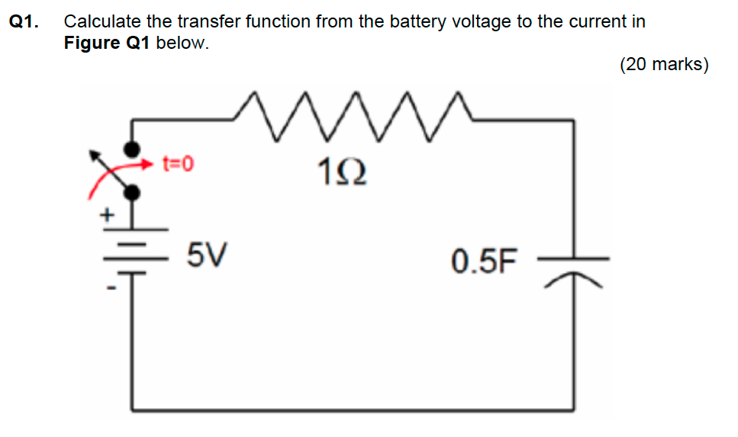
Q1: Electrical system
Solution: Summing voltages around circuit we have

Slide 18
Q1: Electrical system
Taking Laplace transforms of the voltage equation
Taking out the factor I(s)
Rearranging we get the following transfer function
Substituting in C=0.5F, R = 1Ω

Slide 19
ROCO218: Control Engineering Dr Ian Howard Tutorial 1 2016 exam for ROCO319 Modern Control Solutions to relevant questions

Slide 20
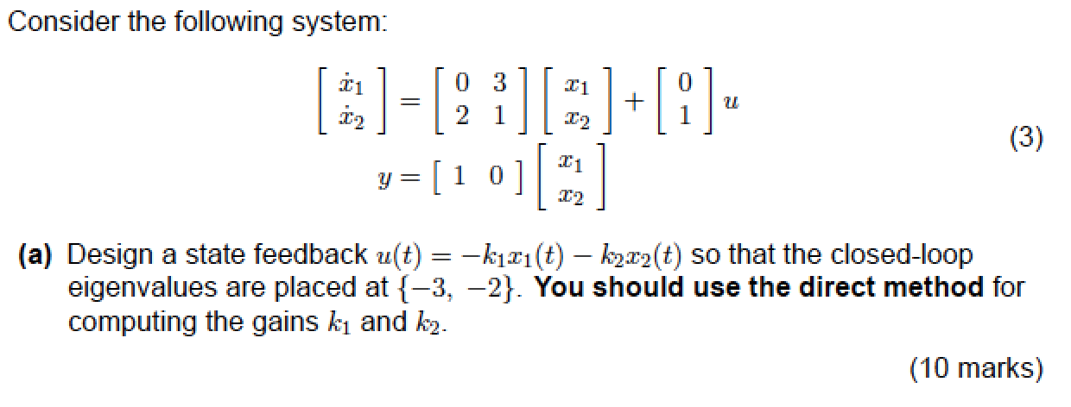
Q3: State space control

Slide 21
Q3: State space control
State space equations take the form
The given system state space equations are
Therefore the system matrices are

Slide 22
Q3: State space control
We now apply feedback to the state space equation
By setting input U to
where
This leads to the the modified relationship
So the stability is now determined by location of poles which are the eigenvalue of matrix (A-BK)
The eigenvalues λ of the closed loop system are thus given by

Slide 23
Q3: State space control
Using the system matrices
Substituting in values
The characteristic equation is therefore

Slide 24
Q2: State space analysis
Simplifying the characteristic equation
We require that the eigenvalues λ of the controller system are at -3,-2
Therefore we want the following characteristic equation
We now need to match the coefficients in the desired eigenvalues characteristic equation using the appropriate gain vector K
Feedback law is therefore

Slide 25
ROCO218: Control Engineering Dr Ian Howard Tutorial 1 2015 exam for ROCO316 Modern Control Solutions to relevant questions

Slide 26
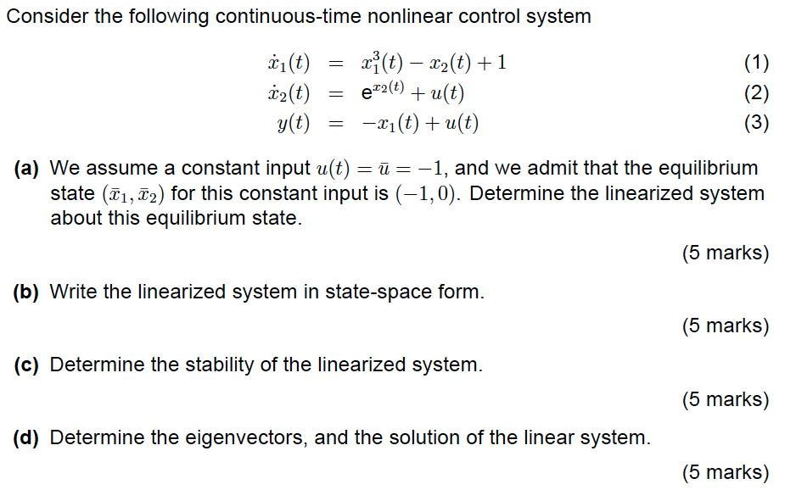
Q1: Continuous-time nonlinear control system

Slide 27
Q1: Continuous-time nonlinear control system
Solution: Substituting in value of u(t) = -1 gives the equations
To linearize we need to calculate the Jacobian matrix and evaluate it at the given equilibrium position (-1,0).
In general the Jacobian is given by

Slide 28
Q1: Continuous-time nonlinear control system
Here we only have a 2x2 matrix
The corresponding functions we need f₁ and f₂ are given by the two state expressions
Taking partial derivatives w.r.t. to the state variables
The equilibrium point is given as (-1,0) so we evaluate the Jacobian matrix at this point

Slide 29
Q1: Continuous-time nonlinear control system
From the Jacobian
we can directly write

Slide 30
Q1: Continuous-time nonlinear control system
To determine the stability of the system we need to calculate the eigenvalues of Jacobian matrix J which is now our system matrix A
The eigenvalues of matrix A must satisfy the equation
Where X is the state vector
Where I is the identity matrix
This equation has a non-zero solution X if and only if the determinant of the matrix (A-I)=0
Where straight bracket signifies the determinant

Slide 31
Q1: Continuous-time nonlinear control system
Substituting A and I into the expression
For a 2x2 matrix the determinant is given by
Note also that since the A matrix is of triangular form, its leading diagonal values indicate the eigenvalues of 3 and 1 directly. However we calculated the values for thoroughness of methodology since this will not always be the case
Both eigenvalues are strictly positive and therefore the linearized system is unstable

Slide 32
Q1: Continuous-time non-linear control system
The eigenvalues of a matrix A satisfy the equation
The values of X gives the eigenvector
When λ=1
When λ=3

Slide 33
ROCO218: Control Engineering Dr Ian Howard Tutorial 1 State space model of spring coupled masses

Slide 34
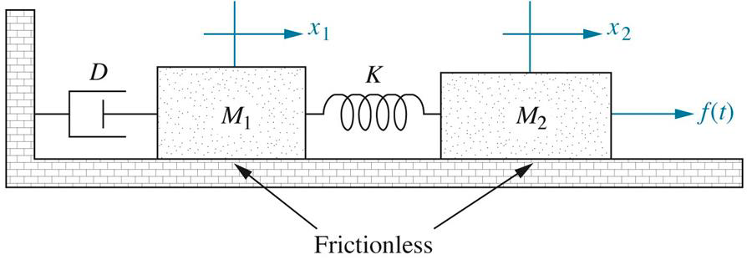
Modelling spring coupled masses
Derive the state space model for the following translational mechanical system whose input is 𝑓(𝑡) and whose output is 𝑥₂:
Identify its states: highest state term must be less than highest differential equation term
Equations of motion are

Slide 35
Modelling spring coupled masses
From 1st equation of motion
From definition of state variables
Reordering

Slide 36
Modelling spring coupled masses
From 2nd equation of motion
From definition of state variables
Reordering

Slide 37
Modelling spring coupled masses
Thus we have
Want matrix format is

Slide 38
Modelling spring coupled masses
Since want output to be x₂
Want matrix format is

Slide 39
ROCO218: Control Engineering Dr Ian Howard Tutorial 1 Analysis of rod pendulum

Slide 40
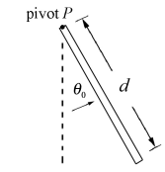
Fixed rod pendulum
Gravitation force acting on center of mass leads to torque
Resistance torque to movement by moment of inertia of system
force=mg
distance
=(d/2).sin(θ)
For rod
For rod around one end
For small angles

Slide 41
Fixed rod pendulum
Linearized equation of motion for rod pendulum
Taking Laplace transforms with zero initial condition
force=mg
distance
=(d/2).sin(θ)

